Slide 1
Module 7: Lesson 2 NoSQL Database Concepts (Part 1)

Slide 2
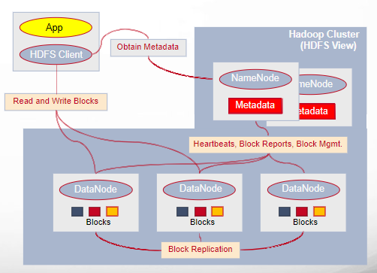
Distributed Storage Partitions
Let’s recall how we handled the storage of massive volumes of data – in particular the use of the Hadoop Distributed File System (HDFS)
If the size of a file exceeded the capacity of any single storage system (data node), our solution was to separate that file into fixed size blocks and distribute them across multiple storage systems (data nodes)
Further, to ensure fault tolerance, we created multiple replicas of each file block on multiple storage systems (data nodes
At the same time, we collected metadata, on name nodes, about each file, including its name, and the placement and order of its blocks (including replicas)

Slide 3
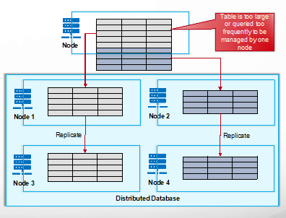
Managing Distributed Storage Partitions
NoSQL databases often employ a similar technique call partitioning to distribute tables or collections of massive size across a cluster
A massive database table or collection too large to be stored on a single cluster node, is divided into smaller groupings of rows called partitions which are then distributed across multiple nodes
Note, each node can store partitions from one or more tables or collections
This allows for the storage of massive tables, parallel processing of queries and improves scalability as additional nodes can be easily added to handle growing data volumes.
Replicas of a partition can be stored on different nodes, allowing the system to continue operating even if some nodes fail.

Slide 4
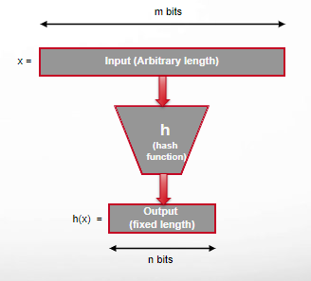
Realizing Partitions Hash Function
A hash function, denoted as h(x) takes an arbitrary input (x) and maps it to a fixed-size output (hash value) in a consistent and deterministic way
Consistency: For any given input x, the hash function h consistently produces the same hash value h(x) every time it is executed.
Deterministic: Different input elements x and y (except for potential collisions) will always map to distinct hash values h(x) and h(y), respectively.
A hash function collision occurs when two different inputs end up with the same output (hash value) after being processed by the hash function
Collisions can be made rare when using good hash functions, and can be addressed with some additional bookkeeping

Slide 5
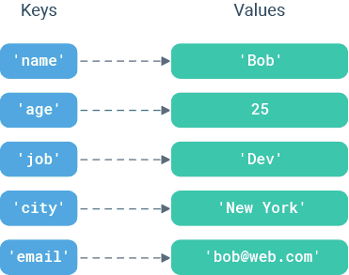
Realizing Partitions Key-Value Pairs
This is a fundamental data structure where data is stored as a combination of a unique identifier (key) and its associated value
Key-value pairs serve as a fundamental record representation for several NoSQL database types
Imagine a database record where the "key" is a word and the "value" is its definition
As a database record, the key acts as a unique identifier (primary key), within the scope of a table or collection, for the associated value
This structure offers efficient retrieval based on searching or querying a record based on its unique key.

Slide 6
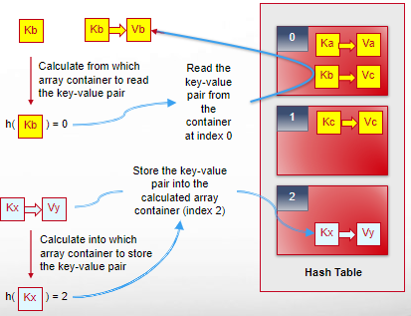
Realizing Partitions Hash Table
A hash table is a data structure designed for storage and retrieval of key-value pairs based on a key.
It utilizes an array of container to store key-value pairs and a hash function to map keys to specific container indices within the array.
This hash function takes a key as input and generates a hash value (array index).
To write a key-value pair to the table, you apply a hash function to the key to determine into which array container the key-value pair should be stored
To read a key-value pair given its key, you use the hash function to determine in which container the record is stored and then retrieve it

Slide 7
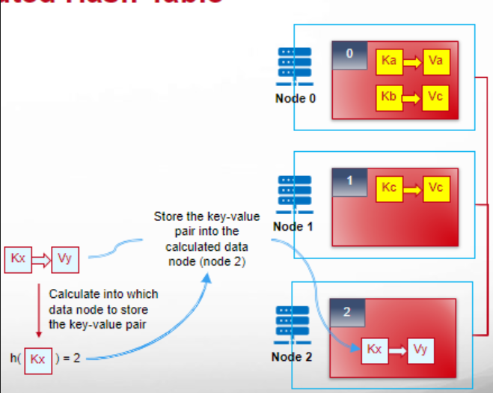
Realizing Partitions Distributed Hash Table
A Distributed Hash Table (DHT) is a data structure specifically designed for distributed storage and retrieval of key-value pairs across a cluster of nodes
DHTs employ sharding to partition key-value pairs based on a chosen criteria (e.g., hash function on a key). This distributes data across the nodes in the cluster.
The DHT uses a hash function to map the key to a specific node responsible for storing the corresponding value
Retrieving data involves determining the node responsible for the specific key by applying the same hash function to the query key
Some DHTs uses a dedicated server that maintain information about cluster data distribution and directs queries to the appropriate nodes

Slide 8
Denormalization
Most NoSQL databases do not support joins across multiple related tables (entities) due to the performance overhead of moving large volumes of data across a network to perform the join
Instead denormalization involves combining data about multiple related entities together a single table. This creates pre-joined data, allowing for retrieval of combined information.
Denormalization can eliminate joins but it can introduce duplication, which can lead to more expensive updates and inserts, and increased storage requirements
By bypassing distributed joins, denormalization significantly accelerates read operations.
Maintaining data consistency becomes more challenging as updates need to be reflected in all relevant table records where data is duplicated.

Slide 9
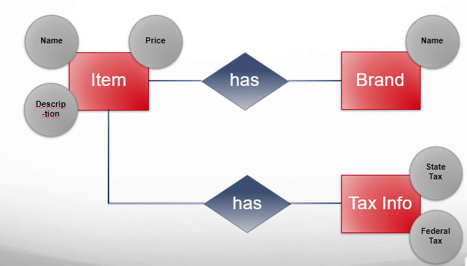
Denormalization Example – ER Diagram

Slide 10
Denormalization Example – Normal Form
Items
Item ID | Brand ID | Tax Info ID | Name | Price | Description
123 | 400 | 777 | Broom | $19.99 | Straw Bristles
456 | 400 | 777 | Broom | $23.49 | Plastic Bristles
Foreign Key
Relationship
Foreign Key
Relationship
Brands
Tax Info
Brand ID | Name
400 | ACME
500 | Fuller
Tax ID | State Tax | Federal Tax
777 | 0.05 | 0.16
789 | 0.07 | 0.07

Slide 11
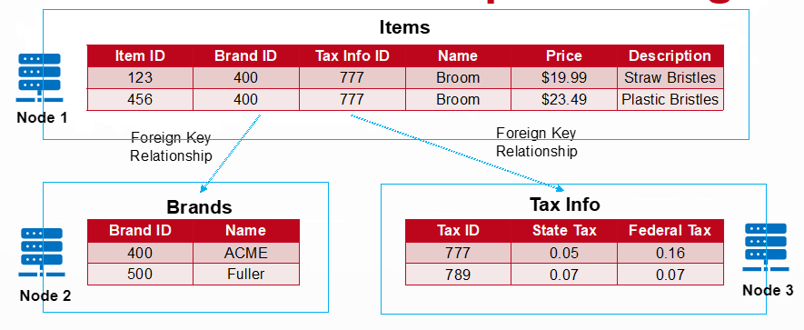
Denormalization Example – Using Joins
SELECT Items.ItemID, Items.Name, TaxInfo.StateTax FROM Items INNER JOIN TaxInfo
ON Items.TaxInfoID = TaxInfo.TaxID
WHERE Items.ItemID = 123
Data must move across the network between Node 1 and Node 3

Slide 12
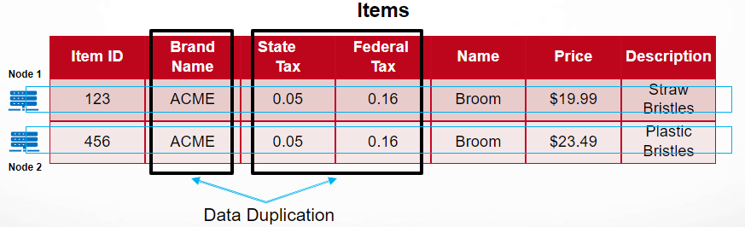
Denormalization Example – Denormalized Form
No data movement across nodes
SELECT ItemID, Name, StateTax FROM Items WHERE ItemID = 123

